Slide 1
Marketing

Slide 2
Business environment

Slide 3
Business environment
Business environment means all of the internal and external factors that affect how the company functions, including employees, customers, management, supply and demand and business regulations.
Micro / Internal marketing environment: An internal marketing environment consists of factors that fall within your control and impact your marketing operations, including your organization's strengths, weaknesses, uniqueness, and competencies.
Macro / External marketing environment: The external marketing environment includes all factors that do not fall within your organization's control, including technological advancements, regulatory changes, social, economic, and competitive forces.

Slide 4

Internal environment
(1) Policies and plans
(2) Mission and Objectives
(3) Organization Structure
(4) Corporate Culture
(5) Quality of Human Resources
(6) Labor Unions
(7) Physical Resources and Technological Capabilities.
(8) Capital/Assets/Liabilities management

Slide 5

External environment
1. Economic Environment
2. Social Environment
3. Politico-Legal Environment
4. Technological Environment
5. Competitive or Market Environment
6. Global Environment
7. Socio-economic Environment
8. Natural Environment
9. Socio-Cultural Environment
10. Educational and Cultural Environment
11. Political environment

Slide 6
External environment
The global environment consists of the macro-environment which forms the larger forces that can affect the global business objectives, these could be related to technology, nature, economy.
Politico-Legal Environment : It provides the legal framework within which the business is to function. The viability of business depends upon the ability with which it can meet the challenges arising out of the politico-legal environment. The politico-legal environment of a country is influenced by political organization, political stability. Government’s intervention in business, constitutional provisions affecting business, foreign policy, etc.
Socioeconomic environment is concerned with the relationship between social and economic factors within society. These factors influence how a particular group or socioeconomic class behave within society, including their actions as consumers.
Natural environment: factors like climate, minerals, soil, landform, rivers and oceans, coastlines, natural resources, flora and fauna, etc. are part of it. t is the natural environment which decides the resources for any business
The socio-cultural environment includes mobility of labor, customs and convention, caste structure, cultural heritage, respect for elders, ethics and values, view towards scientific methods, and deference for seniority.
Competitive environment is the dynamic external system in which a business competes and functions. The more sellers of a similar product or service, the more competitive the environment in which you compete.

Slide 7
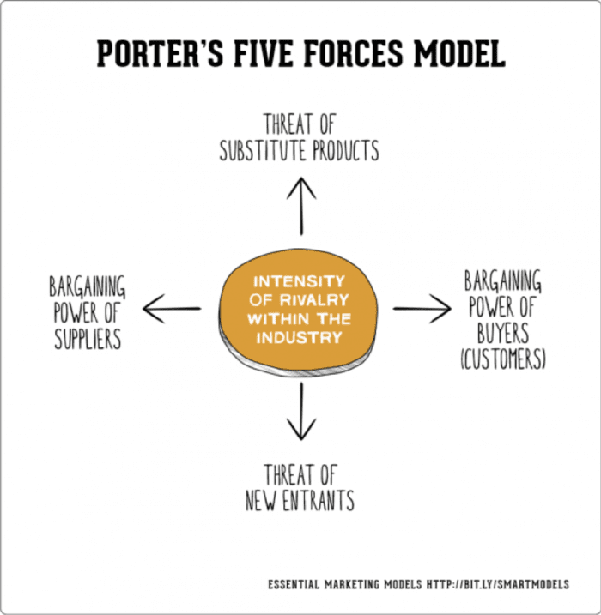
Porter’s five forces model
Porter’s Five Forces analysis is a framework that helps analyzing the level of competition within a certain industry. According to this framework the state of competition in an industry depends on five basic forces: threat of new entrants, bargaining power of suppliers, bargaining power of buyers, threat of substitute products or services, and existing industry rivalry. The collective strength of these forces determines the profit potential of an industry and thus its attractiveness.

Slide 8
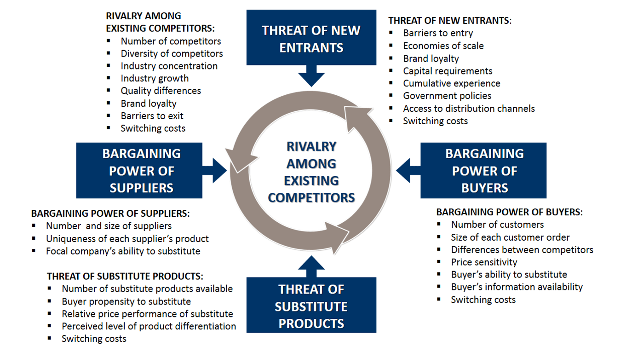
Porter’s five forces model

Slide 9
(a) Threat of new entrants – If the demand of an industry is increasing and it is more profitable than other industries, new units will be attracted to the industry. The new units will compete for raw materials, capital and market share.
(b) Bargaining power of customers – If the customers constitute a powerful group, they would have greater bargaining power in price negotiations. They will ensure lower prices which means lesser profits for the business.
(c) Bargaining power of suppliers – If the suppliers re united and powerful, they can increase the price
of materials and also insist on cash payment. This might pose a great challenge for the firm.
(d) Availability of substitutes – If cheaper substitutes are available, the business firm will be left with lower demand and lower profits. For instance, jute industry has been outstripped by petro-chemical based products and packaging materials.
(e)Rivalries amongst competitors– The individual units within an industry might compete with each other for attaining the commanding position. They may use tactics like price competition, introduction of new features and promotional activities to increase their share in the market.

Slide 10
Application of the Model
Define the industry: The process begins with a clear description of the industry.
Identify the key players: Specify and group the major factors in the sector into strategic categories based on relevant criteria.
Assess the strategic strengths: This means evaluating the firm and its industry to determine the best strategies that can be applied.
Analyze the industry structure: This involves examining the overall structure of the industry, particularly the factors that influence how profitable it is.
Evaluating the competitive forces: A detailed analysis of the five competitive forces: assessing their positive and negative effects, and then looking forward to any changes in these forces ahead.
Identify the factors you have some control over: List down the aspects of the industry structure that could be influenced by competitors, new market entrants, or your firm. In sum, what can be changed.

